Slide 1


고객가치
새로운 시도
집요한 실행
Lens Calibration

Slide 2
Lens Calibration
Jasper
Errors in Geometrical optics
Aberrations
Caused by the Paraxial approximation. → The first-order theory, $\sin{θ \sim θ},\tan{θ \sim θ,\cos{θ \sim 1}}$
Monochromatic aberrations
Spherical aberrations
Marginal rays are bent too much or less.
Ludwig Von Siedel first studied these aberrations in 1850s.
It is often called Siedel aberrations.
Coma
The principal plane is a ‘plane’ only in the paraxial region.
Astigmatism
The incident cone of rays strikes the lens asymmetrically.
Field curvature
Planar object normal to the optical axis is imaged as a plane only in the paraxial region.
Distortions
Different areas of the lens has different focal lengths and different magnifications.
Radial
Barrel
Pincushion
Chromatic aberrations
Mustache
The actual index of a material is a function of frequency.
Tangential
etc…

Slide 3

Lens Calibration
Jasper
Errors in Geometrical optics
Aberrations
Caused by the Paraxial approximation. → The first-order theory, $\sin{θ \sim θ},\tan{θ \sim θ,\cos{θ \sim 1}}$
Monochromatic aberrations
Spherical aberrations
Coma
Astigmatism
Field curvature
Distortions
Can be modeled with Brown-Conrady model
Radial
$→$ A fee library is provided by OpenCV
Barrel
Pincushion
Chromatic aberrations
Mustache
Tangential
etc…

Slide 4
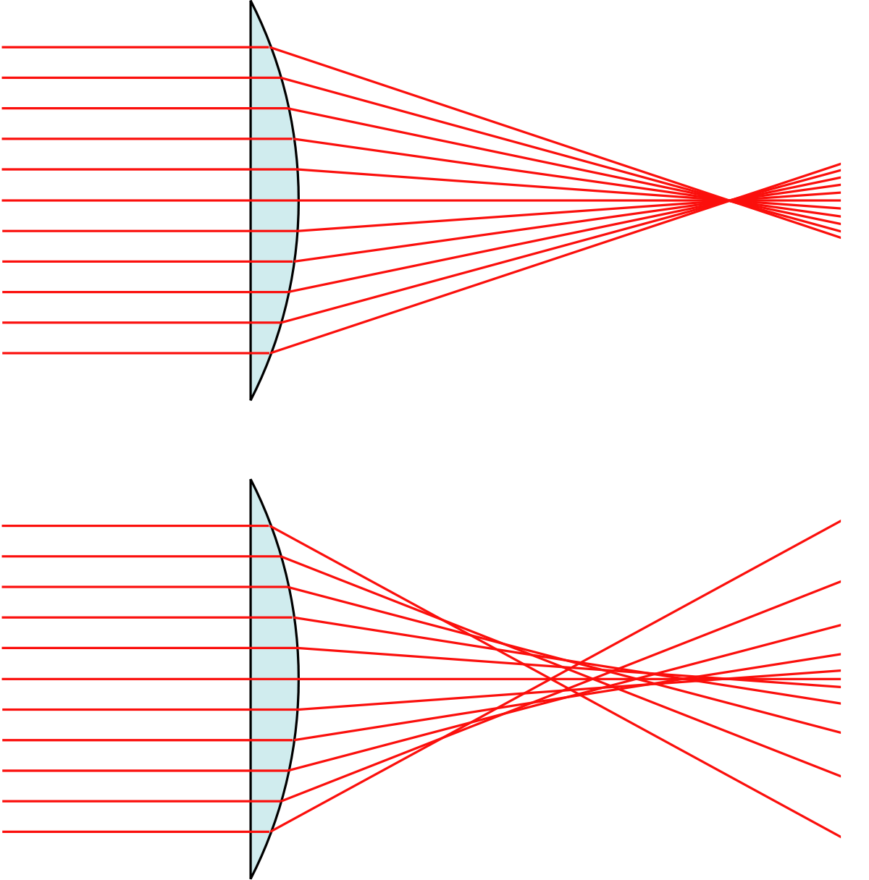
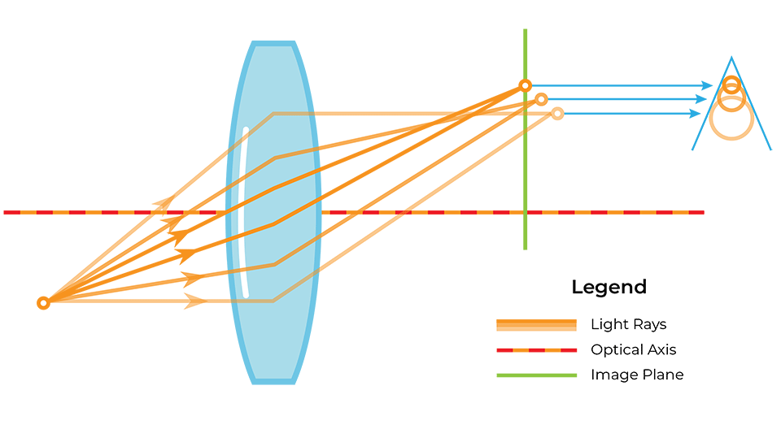
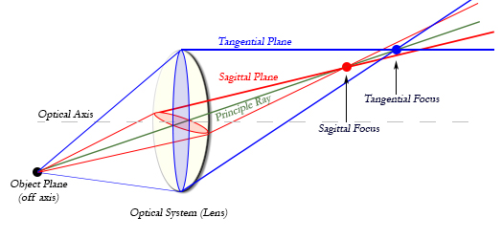
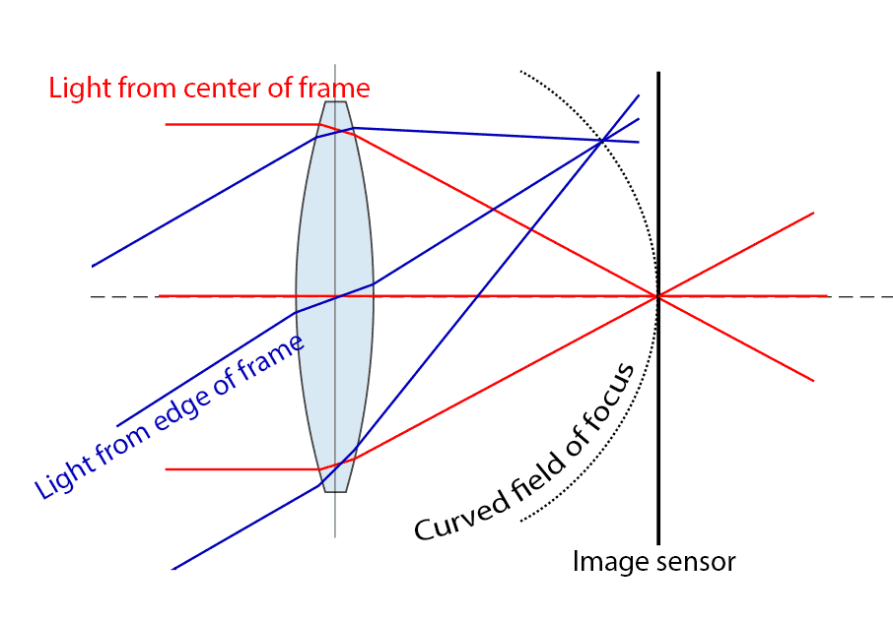
Lens Calibration
Jasper
Spherical aberration
Coma (Comatic aberration)
Astigmatism
Field curvature

Slide 5
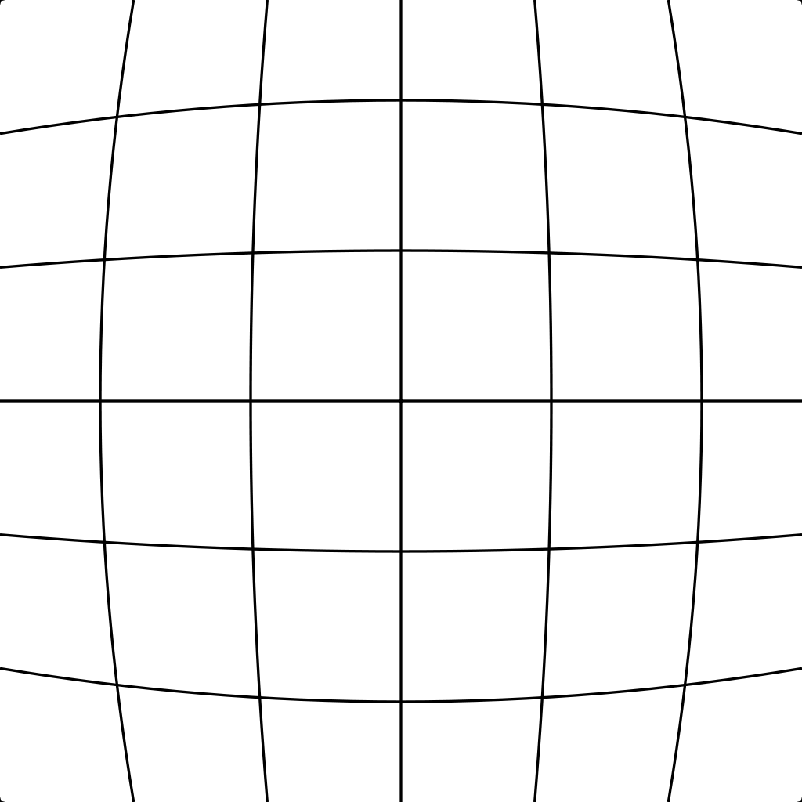
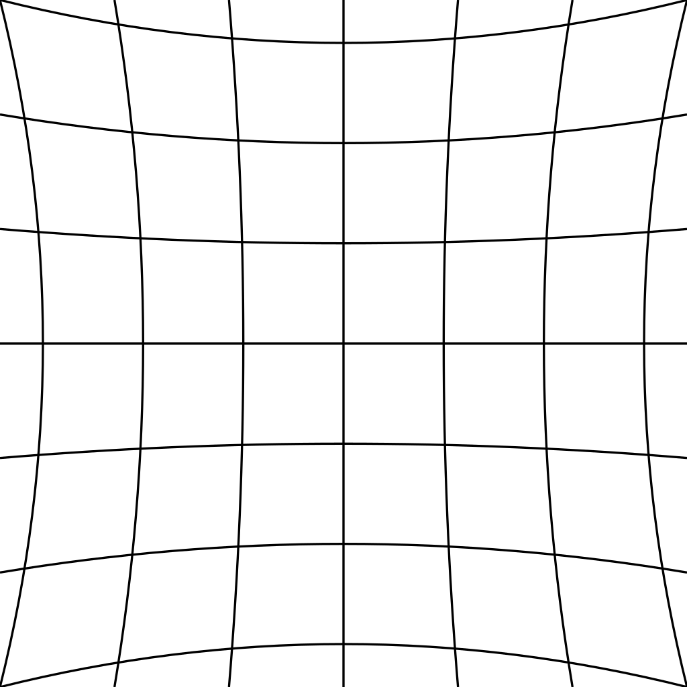
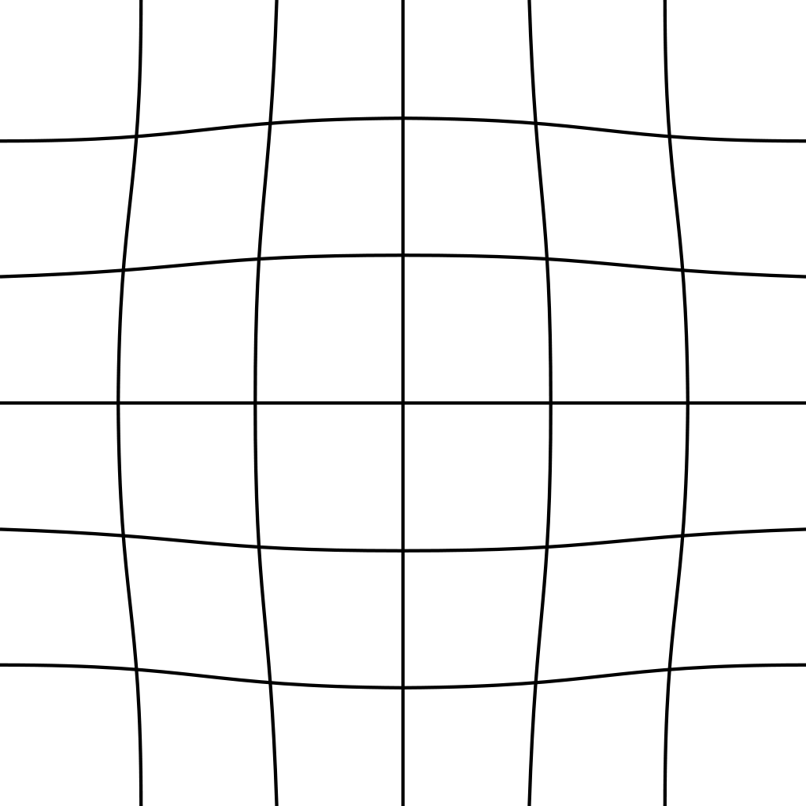
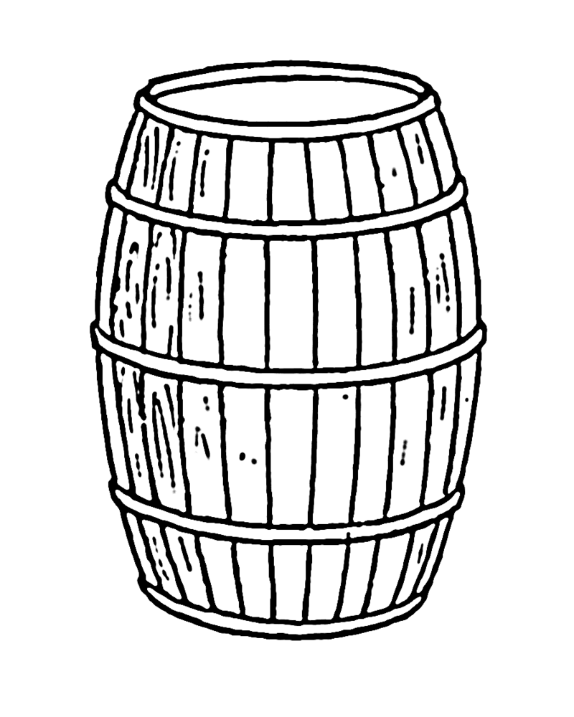


Lens Calibration
Jasper
The three most common radial distortions
Barrel distortion
(positive radial distortion)
Pincushion distortion
(negative radial distortion)
Mustache distortion
(complex distortion)
degree 2
degree 2
degree 4

Slide 6
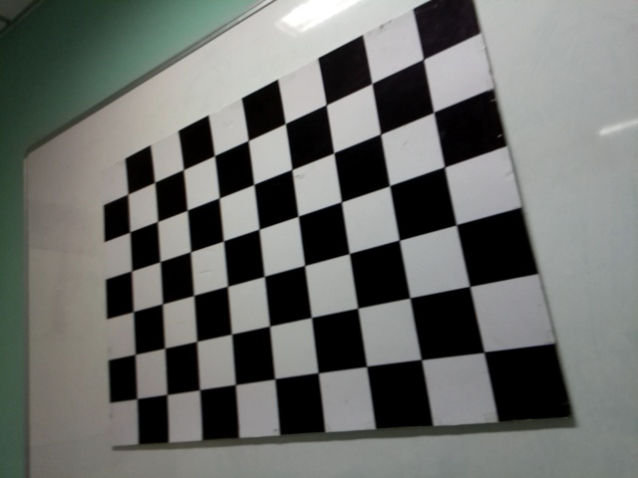
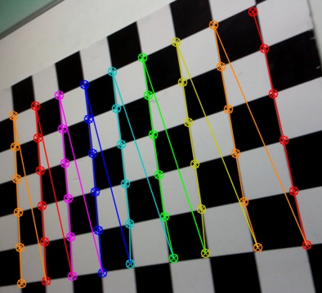

Lens Calibration
Jasper
OpenCV python test code: Spot searching
Before
After

Slide 7
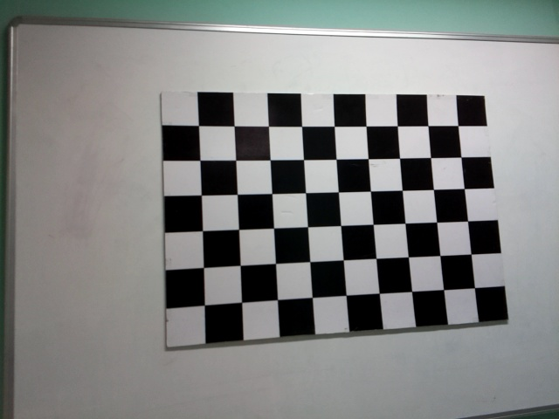
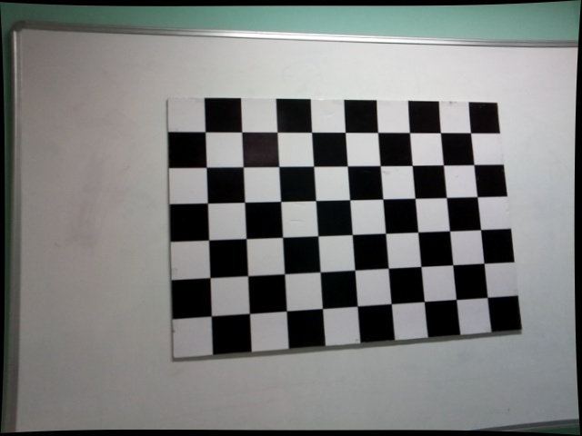
Lens Calibration
Jasper
OpenCV python test code: Undistort the image
Before
After
Barrel distortion

Slide 8
Lens Calibration
Jasper
Can it be directly applied to IMX459?

Slide 9
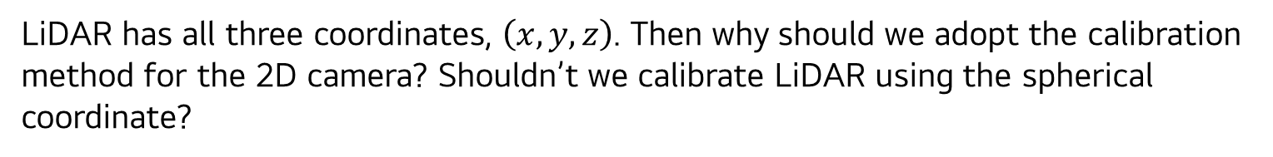
Lens Calibration
Jasper
LiDAR has all three coordinates, $\left(x,y,z\right)$. Then why should we adopt the calibration method for the 2D camera? Shouldn’t we calibrate LiDAR using the spherical coordinate?

Slide 10
고객가치
새로운 시도
집요한 실행
Error Source in dToF LiDAR with SPAD sensor

Slide 11
Error Source in dToF LiDAR with SPAD sensor
Lens
TDC
DNL
Clock speed
SPAD
Current-Voltage Characteristics (I-V)
Dark Count Rate (DCR)
Fill Factor (FF)
Photon Detection Probability (PDP)
Timing Jitter
After-pulse Probability

Slide 12
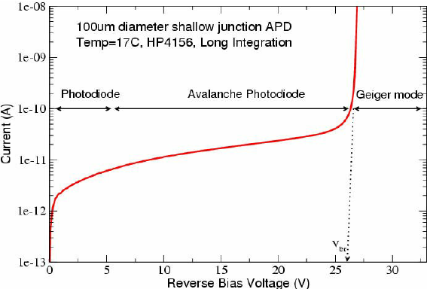
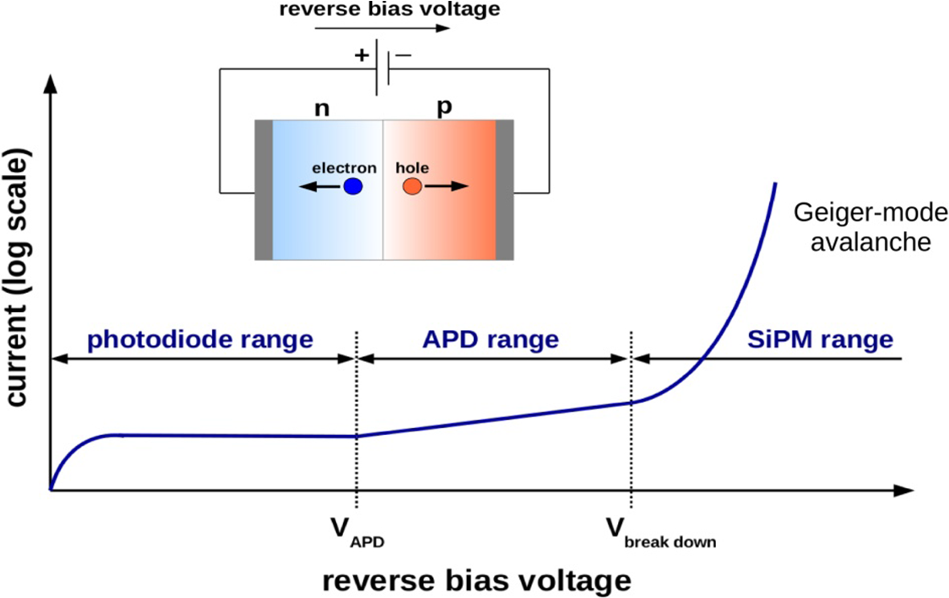
Error Source in dToF LiDAR with SPAD sensor
Examples of Geiger-Mode Operation

Slide 13
Error Source in dToF LiDAR with SPAD sensor
Examples of Geiger-Mode Operation
Since SPAD can detect a single photon,
there is no need for setting threshold voltage.
Image from

Slide 14
Error Source in dToF LiDAR with SPAD sensor
Examples of Geiger-Mode Operation
Since SPAD can detect a single photon,
there is no need for setting threshold voltage.

